Slide 1


Nutan Maharashtra Vidya Prasarak Mandal’s NUTAN COLLEGE OF ENGINEERING AND RESEARCH Under Administrative Support of Pimpri Chinchwad Education Trust ISO 21001:2018 EOMS Certified
Mini Project Review II
Presentation on
Camouflage Detection
By
Aman Javed Maner
Pratik Sarjerao Gade
Harshad Bharat Bhosale
Under the guidance of
Prof. Priyanka Vyas
Department of Computer Science and Engineering
( Artificial Intelligence )

Slide 2
Nutan Maharashtra Vidya Prasarak Mandal’s NUTAN COLLEGE OF ENGINEERING AND RESEARCH Under Administrative Support of Pimpri Chinchwad Education Trust ISO 21001:2018 EOMS Certified
Mini Project Review II
Introduction :
Camouflaged Target Acquisition is a critical aspect of modern defense and surveillance systems, presenting unique challenges in detecting concealed threats within complex environments. Unlike traditional surveillance systems, which primarily focus on moving target detection and tracking, camouflaged target acquisition requires advanced techniques to identify hidden objects or individuals. Deep learning models, such as the You Only Look Once (YOLO) model, have revolutionized object detection and counting tasks in surveillance applications. However, detecting camouflaged targets demands even greater sophistication and precision. This presentation explores the complexities of camouflaged target acquisition, highlighting the advancements, challenges, and future directions in this critical area of defense and security technology.

Slide 3
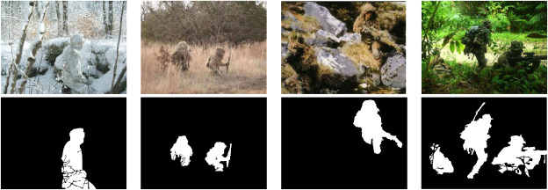
Nutan Maharashtra Vidya Prasarak Mandal’s NUTAN COLLEGE OF ENGINEERING AND RESEARCH Under Administrative Support of Pimpri Chinchwad Education Trust ISO 21001:2018 EOMS Certified
Mini Project Review II

Slide 4
Nutan Maharashtra Vidya Prasarak Mandal’s NUTAN COLLEGE OF ENGINEERING AND RESEARCH Under Administrative Support of Pimpri Chinchwad Education Trust ISO 21001:2018 EOMS Certified
Mini Project Review II
Problem Statement :
Camouflaged Target acquisition using Deep learning especially YOLOv8 and Segment Anything Model for detecting , tracking Camouflaged Target
Objective :
Human detection and counting system using YOLO (You Only Look Once) version 8 for robust and efficient identification, tracking, and counting of human subjects in video streams .Furthermore implementation in security cameras and drones .
Main objectives are as
Image Segmentation
Detecting Target
Tracking Target
Alert Generation

Slide 5
Nutan Maharashtra Vidya Prasarak Mandal’s NUTAN COLLEGE OF ENGINEERING AND RESEARCH Under Administrative Support of Pimpri Chinchwad Education Trust ISO 21001:2018 EOMS Certified
Mini Project Review II
Literature Survey (Research Paper) :
Camouflage target detection based on strong semantic information and feature fusion
Author : Junhua Yan , Xutong Hu , Yun Su, Yin Zhang, Mengwei Shi, and Yinsen Gao
A new camouflage target detection algorithm, YOLO, is proposed to address challenges like target background similarity and edge damage. It incorporates a Convolutional Block Attention Module (CBAM) to highlight important features and spatial locations, alongside an atrous spatial pyramid pooling module for multiscale feature sampling. Attention skip-connections enhance feature fusion. Tested on the Strong Camouflage Efficiency Target Dataset (SCETD), the algorithm achieves 96.1% precision, 87.1% recall, 92.3% AP0.5, and 54.4% AP0.5∶0.95, demonstrating its effectiveness.
2. Towards Deeper Understanding of Camouflaged Object Detection
Author : Yunqiu Lv], Jing Zhang], Yuchao Dai*, Aixuan Li, Nick Barnes and Deng-Ping Fan
Camouflaged objects in nature evolve as a defense mechanism against predators. Traditional binary segmentation methods fail to fully capture the complexity of camouflage. We propose a triple-task learning framework that simultaneously localizes, segments, and ranks camouflaged objects based on their conspicuousness. We generate datasets using eye tracking and instance evel labels. Our approach outperforms existing methods and offers a more comprehensive understanding of camouflage.

Slide 6
Nutan Maharashtra Vidya Prasarak Mandal’s NUTAN COLLEGE OF ENGINEERING AND RESEARCH Under Administrative Support of Pimpri Chinchwad Education Trust ISO 21001:2018 EOMS Certified
Mini Project Review II
3. Camouflaged Object Detection with a Feature Lateral Connection Network Author : Tao Wang 1 , Jian Wang 1,* and Ruihao Wang 2
We introduce FLCNet, a novel framework for camouflaged object detection (COD) comprising three modules: underlying feature mining (UFM), texture-enhanced (TEM), and neighborhood feature fusion (NFFM). Our approach addresses the issue of low-level feature texture extraction by deeply mining underlying features and eliminating interference. Inspired by biological evolution, NFFM combines high-level and low-level information for precise prediction maps. FLCNet outperforms 21 deep-learning-based models on four benchmark COD datasets, demonstrating its effectiveness.
4. An Evaluation Method of Dynamic Camouflage Effect Based on Multifeature Constraints
Author : Yuanying Gan; Chuntong Liu; Hongcai Li; Bin Wang; Shixin Ma; Zhongye Liu
This paper introduces a novel method for evaluating camouflage effectiveness in videos, addressing limitations of existing static image methods. It comprises two modules: Homo-F target detection utilizing homography transformation and optical flow, and a camouflage effect evaluation module. The latter assesses camouflage from various angles such as fusion degree, repetition rate, and target detection stability. Experimental results demonstrate the method's objectivity and accuracy in evaluating moving targets' camouflage levels, validating its reliability and effectiveness.

Slide 7
Nutan Maharashtra Vidya Prasarak Mandal’s NUTAN COLLEGE OF ENGINEERING AND RESEARCH Under Administrative Support of Pimpri Chinchwad Education Trust ISO 21001:2018 EOMS Certified
Mini Project Review II
Methodology :
Data Collection: Gather relevant data, including images or videos of environments where camouflaged targets may be present. This data should encompass various scenarios and conditions to ensure comprehensive training and testing of the detection system.
Feature Extraction: Extract relevant features from the preprocessed data to capture important characteristics that distinguish camouflaged targets from the background. These features may include color, texture, shape, and motion information.
Model Selection: Choose an appropriate detection model or algorithm suited for camouflaged target acquisition. This could involve traditional computer vision techniques, machine learning algorithms, or deep learning architectures, depending on the complexity of the task and the available data.
Training: Train the selected model using the preprocessed data. This involves feeding the model with labeled examples of camouflaged targets and background elements to learn to distinguish between them effectively. Fine-tuning and optimization may be necessary to improve the model's performance.
Evaluation: Evaluate the trained model's performance using validation datasets or through cross-validation techniques. Measure metrics such as accuracy, precision, recall, and F1 score to assess the model's effectiveness in detecting camouflaged targets while minimizing false positives and negatives.
Deployment: Deploy the trained model in real-world scenarios for camouflaged target acquisition. Monitor its performance and gather feedback to continuously refine and improve the system over time.

Slide 8
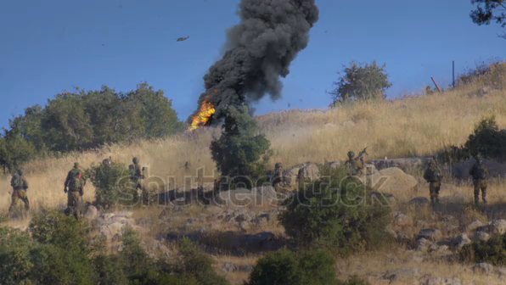
Nutan Maharashtra Vidya Prasarak Mandal’s NUTAN COLLEGE OF ENGINEERING AND RESEARCH Under Administrative Support of Pimpri Chinchwad Education Trust ISO 21001:2018 EOMS Certified
Mini Project Review II
Results :
Undetected Camouflaged Target

Slide 9
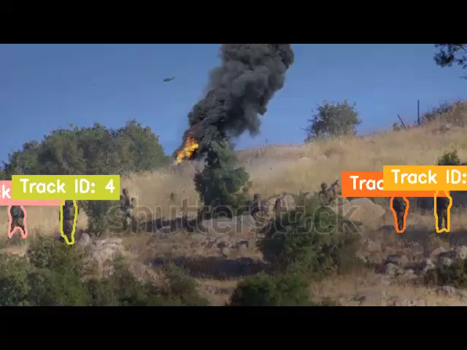
Nutan Maharashtra Vidya Prasarak Mandal’s NUTAN COLLEGE OF ENGINEERING AND RESEARCH Under Administrative Support of Pimpri Chinchwad Education Trust ISO 21001:2018 EOMS Certified
Mini Project Review II
Detected Camouflaged Target

Slide 10
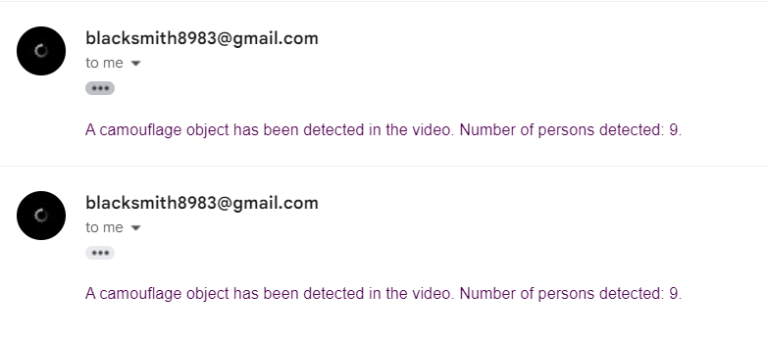
Nutan Maharashtra Vidya Prasarak Mandal’s NUTAN COLLEGE OF ENGINEERING AND RESEARCH Under Administrative Support of Pimpri Chinchwad Education Trust ISO 21001:2018 EOMS Certified
Mini Project Review II
Alert Generated through email :

